Slide 1
Local Governance Matters: Civil Communication in the Current Climate
Dennis Cooley
Director, Northern Plains Ethics Institute at NDSU
Notes:
---
This presentation explores the crucial aspects of ethical and civil governance, emphasizing transparency, accessibility, and strategies to foster trust and inclusivity in society.

Slide 2
Northern Plains Ethics institute
Mission:
  To promote democratic participation in social and ethical issues affecting the Northern Plains and beyond.
Focal questions:
  What kind of society do we want to live in?
  How do we get there?
Process
  Through civil, thoughtful discussion, stakeholders answer the questions as a community.
  This requires understanding the stakeholders as they are rather than how we wish they would be.

Slide 3
Civil Conversations require
Principle of Charity
  Assume the person is intelligent and has something important to say.
  Create the best case for what is said, and then draw conclusions on the evidence alone.
Questions of Meaning Come before Questions of Truth
  Before deciding if something is true or false, make sure you understand what it means.
Fallibilism
  Entering all interactions with the conviction that you could be wrong, even on core beliefs and values.
  Humility to learn from others

Slide 4
Strengths and Challenges in Civil Governance Today
Notes:
---
This slide references information from the following file: https://ndusbpos.sharepoint.com/:fl:/r/contentstorage/x8FNO-xtskuCRX2_fMTHLSmDMAiP4XxGgTbkYYtj2FA/Document%20Library/Copilot/Ethical_and_Civil_Governance_Presentation.page?d=waf26cabaf78644c1b8cbf69244061c3a&csf=1&web=1
Modern Strengths in Civil Governance, Contemporary Challenges Facing Governance

Slide 5

Modern Strengths in Civil Governance
Access to Information: Widespread access to information empowers citizens with knowledge to participate actively in governance.
Digital Engagement Tools: Digital tools facilitate increased civic engagement and enhanced governmental oversight by the public.
Public Discourse on Equity: Growing public discourse focuses on equity, justice, and representation improving society's governance norms.
  Photo: Catholic World Report

Slide 6
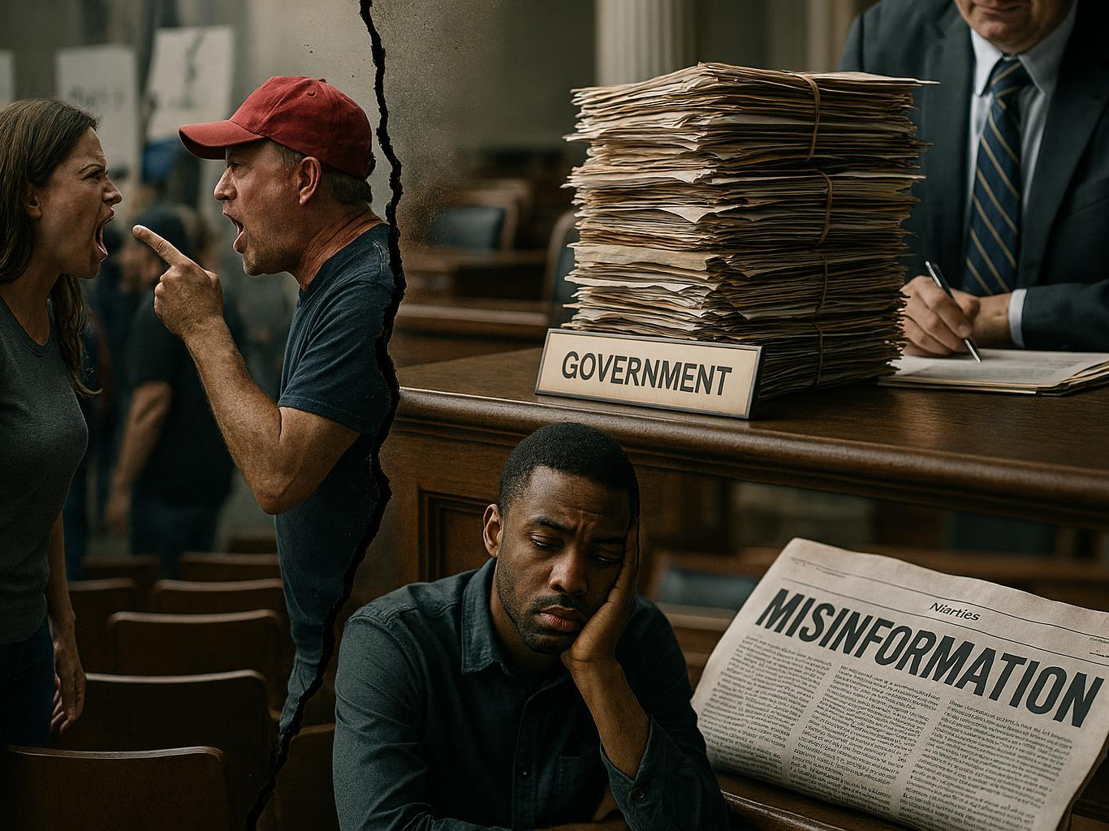
Contemporary Challenges Facing Governance
Political Polarization
  Polarization threatens common ground and disrupts constructive civic dialogue needed for effective governance.
Spread of Misinformation
  Misinformation undermines public institutions and weakens citizen trust in governance systems.
Complex Bureaucracy
  Complex bureaucracy distances citizens from decision-makers, creating barriers to effective participation.
Declining Civic Participation
  Reduced civic participation lowers accountability pressures on leaders, weakening democratic oversight.

Slide 7
Conservatives and Liberals: Differences in emphasis/prioritizing, not values
Conservatives:
  tradition,
  individual responsibility,
  loyalty,
  authority,
  sanctity (binding values), and
  limited government
Liberals:
  equality,
  social justice,
  collective action,
  care,
  fairness, and
  more extensive government.

Slide 8
Key Differences in Valuing
Role of Government: Conservatives advocate for limited government involvement to maximize individual liberty and free markets. Liberals view the state as essential for ensuring equality, protecting civil rights, and providing social safety nets.
Moral Foundations: Research suggests conservatives build moral systems on 5 pillars (care, fairness, loyalty, authority, sanctity), whereas liberals focus primarily on care and fairness.
Change and Tradition: Conservatives tend to prioritize stability, tradition, and order (high conscientiousness). Liberals tend to be more open to change and social evolution.
Scope of Compassion: Liberals often demonstrate "universalist" compassion for people in general, while conservatives often show "parochial" compassion for their immediate, in-group.
Core Beliefs: Conservatism is often rooted in self-reliance and national identity, while liberalism emphasizes equality and individual expression.

Slide 9
Psychological and Emotional Underpinnings
Fear and Security:
  Studies indicate that conservatives often perceive the world as more dangerous, leading to higher support for policing, strong national defense, and border enforcement.
Empathy:
  Liberals generally display higher tendencies for empathy toward diverse groups.
Order:
  Conservatives tend to prefer structure, predictability, and order in their lives.

Slide 10
Ethical and Civil Governance
Current Landscape of Ethical and Civil Governance
Transparency and Accessibility: Pillars of Good Governance
Strategies for Transparent Government
Ensuring Government Accessibility
Pathways to a More Trustworthy and Inclusive Society

Slide 11
Current Landscape of Ethical and Civil Governance
Notes:
---
This slide references information from the following file: https://ndusbpos.sharepoint.com/:fl:/r/contentstorage/x8FNO-xtskuCRX2_fMTHLSmDMAiP4XxGgTbkYYtj2FA/Document%20Library/Copilot/Ethical_and_Civil_Governance_Presentation.page?d=waf26cabaf78644c1b8cbf69244061c3a&csf=1&web=1
The Role of Governance in Society, Key Principles of Ethical Governance

Slide 12

The Role of Governance in Society
Foundation of Stability
  Ethical governance is essential for a stable and just society by promoting fairness and order.
Integrity and Accountability
  Good governance ensures public institutions act with transparency and uphold accountability.
Respect for Rights
  Governance honors the rights and dignity of every individual within society.
Challenges to Democracy
  Democratic norms face pressures, making the strengthening of governance crucial today.
Notes:
---
This slide references information from the following file: https://ndusbpos.sharepoint.com/:fl:/r/contentstorage/x8FNO-xtskuCRX2_fMTHLSmDMAiP4XxGgTbkYYtj2FA/Document%20Library/Copilot/Ethical_and_Civil_Governance_Presentation.page?d=waf26cabaf78644c1b8cbf69244061c3a&csf=1&web=1
The Role of Governance in Society, Key Principles of Ethical Governance

Slide 13

Key Principles of Ethical Governance
Integrity in Governance
  Integrity involves acting honestly and avoiding conflicts of interest in public service.
Fairness in Decision Making
  Fairness requires just, impartial decisions that respect citizens' rights.
Accountability to the Public
  Accountability means taking responsibility and being answerable for one's actions.
Respect for Law
  Respect for law entails upholding rule of law consistently without favoritism.

Slide 14
Transparency and Accessibility: Pillars of Good Governance
Notes:
---
This slide references information from the following file: https://ndusbpos.sharepoint.com/:fl:/r/contentstorage/x8FNO-xtskuCRX2_fMTHLSmDMAiP4XxGgTbkYYtj2FA/Document%20Library/Copilot/Ethical_and_Civil_Governance_Presentation.page?d=waf26cabaf78644c1b8cbf69244061c3a&csf=1&web=1
Why Transparency Is Essential, The Importance of Accessibility

Slide 15
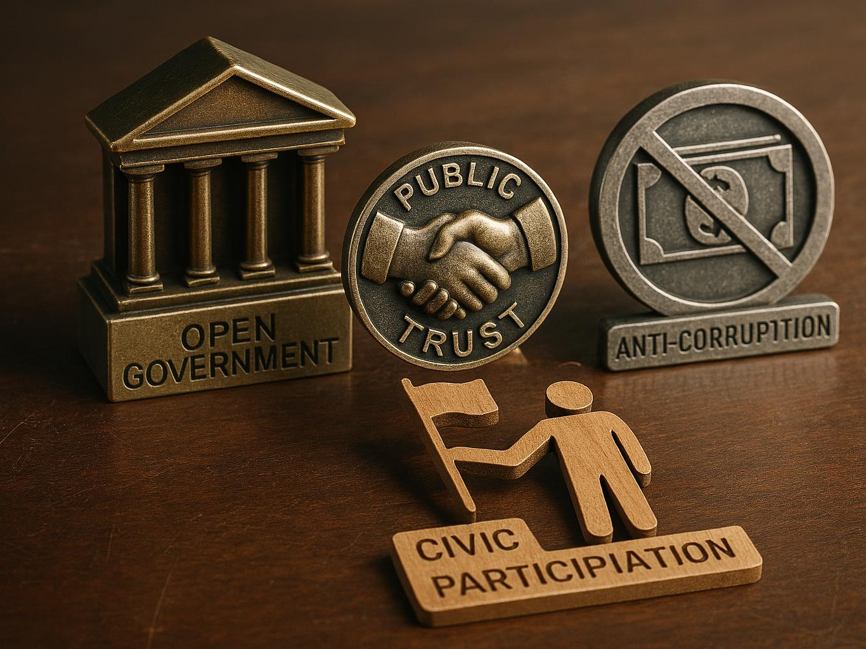
Why Transparency Is Essential
Builds Public Trust
  Transparency fosters trust between the government and citizens by enabling openness and accountability.
Prevents Corruption
  Open access to information helps prevent corruption and abuse of power in governance.
Encourages Civic Participation
  Transparency empowers citizens to participate knowledgeably in civic and political processes.
Enhances Efficiency
  Public oversight driven by transparency improves governmental efficiency and responsiveness.

Slide 16

The Importance of Accessibility
Inclusive Engagement
  Accessibility allows all citizens to participate in government activities despite physical or technological barriers.
Fairness and Equity
  Ensuring accessibility promotes fairness by providing equal opportunities for everyone to be heard and represented.
Diverse Perspectives
  Encouraging accessibility brings diverse viewpoints that improve policy effectiveness and community outcomes.

Slide 17
Strategies for Transparent Government
Notes:
---
This slide references information from the following file: https://ndusbpos.sharepoint.com/:fl:/r/contentstorage/x8FNO-xtskuCRX2_fMTHLSmDMAiP4XxGgTbkYYtj2FA/Document%20Library/Copilot/Ethical_and_Civil_Governance_Presentation.page?d=waf26cabaf78644c1b8cbf69244061c3a&csf=1&web=1
Open Data and Public Information, Public Engagement and Communication

Slide 18

Open Data and Public Information
Publishing Public Data
  Open data initiatives publish budgets, expenditures, and policy documents to enhance transparency and accountability.
Accessible Information
  Providing clear, searchable, and user-friendly access to public information empowers citizens and promotes engagement.
Notes:
---
This slide references information from the following file: https://ndusbpos.sharepoint.com/:fl:/r/contentstorage/x8FNO-xtskuCRX2_fMTHLSmDMAiP4XxGgTbkYYtj2FA/Document%20Library/Copilot/Ethical_and_Civil_Governance_Presentation.page?d=waf26cabaf78644c1b8cbf69244061c3a&csf=1&web=1
Open Data Initiatives
Publish budgets, expenditures, and policy documents.
Provide clear, searchable, and user-friendly access to public information.
Image source: AI-generated

Slide 19

Public Engagement and Communication
Hybrid Public Meetings
  Offering both in-person and virtual options increases access and participation in public forums.
Clear Communication
  Using plain language and targeted strategies helps reach diverse audiences effectively.
Independent Oversight
  Empowering ethics commissions and protecting whistleblowers ensures transparency and accountability.
Notes:
---
This slide references information from the following file: https://ndusbpos.sharepoint.com/:fl:/r/contentstorage/x8FNO-xtskuCRX2_fMTHLSmDMAiP4XxGgTbkYYtj2FA/Document%20Library/Copilot/Ethical_and_Civil_Governance_Presentation.page?d=waf26cabaf78644c1b8cbf69244061c3a&csf=1&web=1
Open Data Initiatives
Publish budgets, expenditures, and policy documents.
Provide clear, searchable, and user-friendly access to public information.
Image source: AI-generated

Slide 20
Ensuring Government Accessibility
Notes:
---
This slide references information from the following file: https://ndusbpos.sharepoint.com/:fl:/r/contentstorage/x8FNO-xtskuCRX2_fMTHLSmDMAiP4XxGgTbkYYtj2FA/Document%20Library/Copilot/Ethical_and_Civil_Governance_Presentation.page?d=waf26cabaf78644c1b8cbf69244061c3a&csf=1&web=1
Digital and Physical Accessibility Measures, Civic Education and Community Partnerships

Slide 21
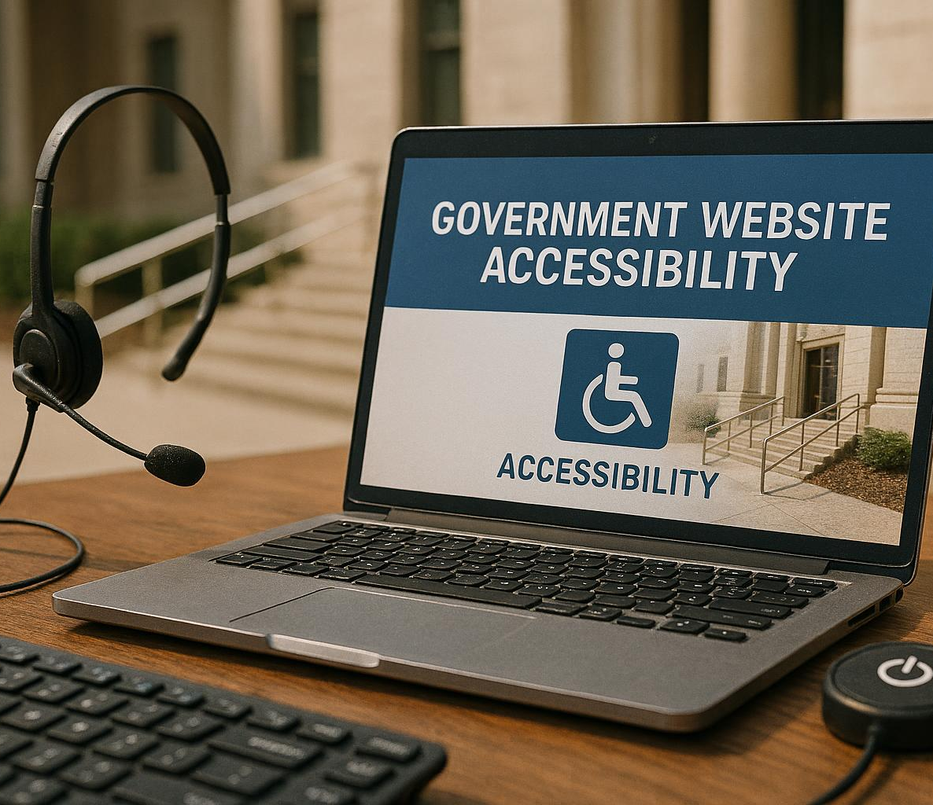
Digital and Physical Accessibility Measures
Digital Accessibility Standards
  Government websites must comply with accessibility standards to ensure usability for all users.
Multilingual and Assistive Resources
  Providing multilingual resources and assistive technologies improves accessibility for diverse populations.
Physical Accessibility Compliance
  Public offices and meeting locations must meet ADA standards for physical accessibility.
Flexible Service Options
  Offering flexible hours or mobile service units increases access to government services.
Notes:
---
This slide references information from the following file: https://ndusbpos.sharepoint.com/:fl:/r/contentstorage/x8FNO-xtskuCRX2_fMTHLSmDMAiP4XxGgTbkYYtj2FA/Document%20Library/Copilot/Ethical_and_Civil_Governance_Presentation.page?d=waf26cabaf78644c1b8cbf69244061c3a&csf=1&web=1
Open Data Initiatives
Publish budgets, expenditures, and policy documents.
Provide clear, searchable, and user-friendly access to public information.
Image source: AI-generated

Slide 22

Civic Education and Community Partnerships
Enhancing Civic Education
  Focus on strengthening civic skills and processes education in K–12 and community settings through partnerships.
University and Library Partnerships
  Collaborate with universities, libraries, and civic organizations to support community learning initiatives.
Community Collaboration
  Work with nonprofits, cultural groups, and leaders to build strong community partnerships.
Hosting Dialogues and Events
  Facilitate community dialogues, listening sessions, and interactive events to engage citizens.
Notes:
---
This slide references information from the following file: https://ndusbpos.sharepoint.com/:fl:/r/contentstorage/x8FNO-xtskuCRX2_fMTHLSmDMAiP4XxGgTbkYYtj2FA/Document%20Library/Copilot/Ethical_and_Civil_Governance_Presentation.page?d=waf26cabaf78644c1b8cbf69244061c3a&csf=1&web=1
Open Data Initiatives
Publish budgets, expenditures, and policy documents.
Provide clear, searchable, and user-friendly access to public information.
Image source: AI-generated

Slide 23
Pathways to a More Trustworthy and Inclusive Society
Notes:
---
This slide references information from the following file: https://ndusbpos.sharepoint.com/:fl:/r/contentstorage/x8FNO-xtskuCRX2_fMTHLSmDMAiP4XxGgTbkYYtj2FA/Document%20Library/Copilot/Ethical_and_Civil_Governance_Presentation.page?d=waf26cabaf78644c1b8cbf69244061c3a&csf=1&web=1
Opportunities for Renewal and Engagement

Slide 24

Opportunities for Renewal and Engagement
Importance of Ethical Governance
  Ethical governance requires continuous reflection and commitment to uphold civil values and trust.
Renewal through Transparency
  Transparency and accessibility create opportunities for renewal in governance and public trust.
Civic Engagement Benefits
  Active civic engagement fosters inclusivity, democracy, and stronger communities and institutions.
Framework for Strengthening Governance
  A structured framework guides reflection on current governance and paths for improvement.
Notes:
---
This slide references information from the following file: https://ndusbpos.sharepoint.com/:fl:/r/contentstorage/x8FNO-xtskuCRX2_fMTHLSmDMAiP4XxGgTbkYYtj2FA/Document%20Library/Copilot/Ethical_and_Civil_Governance_Presentation.page?d=waf26cabaf78644c1b8cbf69244061c3a&csf=1&web=1
Opportunities for Renewal and Engagement

Slide 25
Conclusion
Commitment to Transparency
Transparency in governance fosters trust and accountability among citizens and institutions.
Accessibility and Inclusion
Ensuring accessibility and inclusion empowers all members of society to participate in governance.
Building Trust and Community
Working with the values and principles stakeholders have.
Addressing challenges and leveraging strengths strengthens community trust and civil engagement.

Slide 26
The views expressed here do not necessarily represent those of the state of North Dakota, North Dakota State University, and the Northern Plains Ethics Institute.
Acknowledgment: CoPilot was used to help assemble this PowerPoint.

